Slide 2
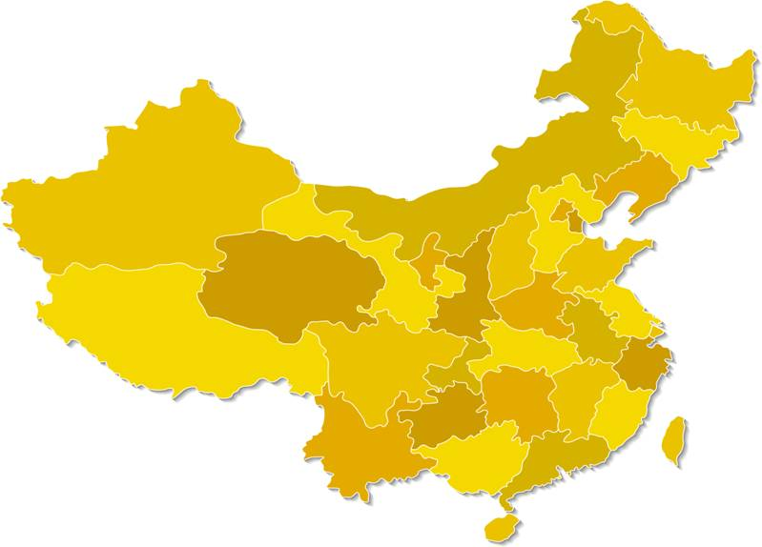
TCS Offices in China
Ken Wong
Calvin Zhang
Fay Ding
Beijing
Shenyang
Qingdao
Nanjing
Chengdu
Wuhan
Shanghai
Chongqing
Vance McEvoy
Claire Zhang
Keith Kan
Peter Liao
Guangzhou
Shenzhen
Jean-Philipe Davignon
Connie Li
Hong Kong
Jaclyn Chan
Notes:
Missions in Beijing, Shanghai, Guangzhou, Chongqing and Hong Kong.
Chongqing has been decided to upgrade to Consulate General of Canada during PM’s visit, with an view of accelerating Canada’s relations with Western China..
6 Canadian Commercial Corporation Regional Offices. Each managed by an Office Manager and an assistant.
CCCRO staff are not sector specific experts but they are locally employees that are familiar with local business culture and network
A group of professionals with preferred access to local business know-how and contact network
Over 150 offices overseas and in Canada
Core Services: Assessing Market Potential, Finding Qualified Contacts, Resolving Problems
Goal: Help Canadian companies succeed internationally and lower your costs and risks of doing business in a foreign market
www.tradecommissioner.gc.ca

Slide 3
Canadian Interest in China
Prime Minister’s visit
Joint Statement on Education Collaboration signed by CMEC and MOE
Increasing number of new clients and services delivered by the TCS
Canada Pavilion at China Education Expo 2011: largest ever in CEE’s record
Notes:
In Winter 2009, Canadian Prime Minister Stephen Harper and Chinese President Hu Jintao issued Canada-China Joint Statement and agreed to foster educational, cultural, business and people-to-people links in order to enrich the long-term development of China-Canada relations.
In 2010, Chinese MOE visited Canada and held the first High-Level Consultation on Education Collaboration with the Council of Ministers of Education.
In June 2011, a CMEC delegation including ministers, DMs and ADMs held in the 2nd High-Level Consultation on Education Collaboration with Chinese MOE in Beijing. They issued a Joint Statement on Education Collaboration and acknowledged that the collaboration will include, among many other things, the enhancement of opportunities for Chinese students to study in Canada.
http://www.cmec.ca/Programs/intrep/Documents/cmec-china-joint-statement-20110629-EN.pdf
As a result, during PM’s recent visit to China, Education was added in the Joint Statement as the fifth pillar to the Canada-China bilateral relation.
400 services each year
25% are new to market clients in the 90 schools that come to exhibit in the China Education Expo

Slide 4
Bilateral Trade Updates
Canada’s second largest trading partner after USA.
In 2011, total export to China:16.8 billion CAD
Foreign Investment Promotion and Protection Agreement
Education and Tourism service industries
Notes:
China is Canada’s second largest trading partner after the US
Top Canadian exports to China in Goods are heavily resource-based: Lumber, Wood Pulp, Ores, mineral fuels.
In 2011, total is 16.5 billion, Wood Pulp was 2.5 billions.
With a close to 30% increase in the number of study permits issued to Chinese students in 2011 compared to 2010. There are currently over 70K Chinese students in Canada. Over 2.1 billion CAD at 30K/ student spending per year.
Education services is one area that Canada has an obvious trade surplus with China.
FIPA negotiation since 1994. The stock of Canadian FDI in China was valued at approximately C$5 billion at the end of 2010. Though current Canadian investment in China is modest, the potential for further investment is substantial.
The stock of foreign direct investment into Canada from China reached approximately C$14 billion at the end of 2010. Chinese firms are actively investing abroad and have expressed a strong interest in investing in Canada. Canadian investment in China covers a broad range of sectors including transportation, biotechnology, education, finance, information technology, manufacturing, and natural resources.
Sectors of interest include natural resources, renewable energy, information and communication technology, food processing, pharmaceuticals and natural medicine, and advanced manufacturing.
Approved Destination Status.
Total TRV visas issued to Chinese 2010: 200,033 2011: 248,888 24.4% increase than 2010.
Story of Ms. Sun Nianbei

Slide 5
CIC Updates
Over 22, 000 study permits issued
Guaranteed Investment Certificate
New Student Partners Program
Study Direct Stream
New ten-year multiple-entry visa
beijing-immigration@international.gc.ca
Notes:
2011
Received over 28000 applications. Issued over 22000 study permits. 26% increase than last year. Majority of the cases finalized within 14 days.
As of March 1, New SPP. In order to qualify for this program applicants must:
Submit a Letter of Acceptance from a participating SPP College or University
Submit a Release of Information form
Submit an IELTS test result form showing average score of 5.5 or higher
Submit a Guaranteed Investment Certificate (GIC) in the amount of $10,000 CAD from a participating Canadian financial institution
Undergo a medical examination before submitting the application
Use one of the Visa Application Centres to submit application
Submit an application at least 15 working days before the start of studies
Study direct stream: a GIC, a direct letter of admission, IELTS over 6

Slide 6
Future Forecast
Market research done by an established Chinese study-abroad service group EIC
Percentage of interviewees interested in going to
US 33.8%,
UK 16.1%,
Australia 12.72%,
Canada 12.68%
12 major education agents reported on average 30% increase of business in 2011
Notes:
Resource : 2012 Chinese Students Study Abroad Forecast, published by the EIC Group.
Among 19000 valid responses from students and parents that have plans of studying abroad.
USA continues to be the market leader. But undergraduate students and high school students are increasing much more rapidly than graduate students. American Education Insitute reported the increase for the undergraduate level is 43% while at the graduate level is only 16%. Which indicates that the graduate level is getting saturated because most of the Chinese students like to go to top universities while the capacity is limited for those universities.
There is also a rapid growth at the high school level. In 2006, only about 60. in 2011. over 6000 Chinese students went to study at high schools in the USA.
Canada is catching up with Australia.
Canada has not got the share that it should.
6

Slide 7
Future Forecast
Main purpose for studying abroad
Notes:
Further findings on the agent survey.
Main Goals for studying abroad
To improve the overall competitiveness in an international working enviroment 69.39%
To learn real practical and useful knowledge and get a well recognized diploma 21.8%
Immigration possibility 5%. We would think this percentage would be higher in reality.
Chinese families are getting richer.
Immigration opportunity equals job opportunity.
Ranking of the schools and the program are equally important.
Other 3.41%
Students in China now are better informed before decision making.
More rational. Going for the real value for money invested in education.
7

Slide 8
Recruitment Opportunities
Local demand will continue to be strong
- The demand can not be met domestically for average students to receive a quality PSE education with great job perspective.
- More affordable
- International experience regarded as a big asset for competing in China’s job market
- generous post study work permit and immigration policy distinguishes Canada in the market place
Notes:
3 Top Reasons
Getting into first tier Chinese universities are highly competitive. Uneven distribution of education resources in China. Starting salary of an undergrad lower than skilled workers.
Renminbi Is appreciating against all major western currency and will continue to be. Domestic inflation. The majority of the families that are supporting their kids studies are middle class with annual income of 45K CAD. This group is increasing . Between 2012-2015, government promises a minimum of 13% family income increase annually. Hurun Report: 960 000 people have net worth more than 10 million RMB
International mobility is increasing. Education is not only a degree. Think in a globally environment
Many students choose a country because of family connections and word of mouth. A top reason for a family to be loyal to one single country. Not same as western countries. Place more value in family ties.
---------------------------
3 Deciding factors
Quality assurance. Lack of means to get official unbiased information. Transparency
Lack of confidence in public education, health and infrastructure systems.
( Chinese parents stopped buying domestic milk powders because of a problem on poisoned milk, now China the largest consumer for canned foreign milk powder. Misuse of public education budget. Hi-speed Railway Accident)
Country is advancing but people’s life not. Big rise in food, real estate and commodity price
Many students choose a country because of family connections and word of mouth.
8

Slide 9
Recruitment Opportunities
Strong presence and rapid growth of Canadian curriculum schools in China
Second-tier city agents as local market leaders
Take advantage of the local community’s links with China
Use of social media promotion
Notes:
Hurun Report (Chinese version of Forbes World Top Rich rankings)
Close to 1 million Chinese people that have a net worth of 10 million RMB
Private business owners and senior executives, people who invest in real estates and in stock market
Now both the stock and the real estate market is down. People have no means to reinvest and have lots of cash. They can buy luxury goods or invest in their children’s education.
Uneven distribution of wealth and education resources are China’s challenge and where Canada’s opportunities are.
Over 40 Canadian curriculum schools and classes are in China and the major players are expanding at a unbelievable speed. (one new school each year) 16500 students. Towards 20, 000.
---------------------------------------------
Both UK and Australia are tightening their immigration policy for foreign students to only allow the elites to stay. While public education should not be an education only for the elites. Canadian education is doing really well to help every ordinary student imagine a bright future and realize their dreams. Focus on student success should be what we promote.
British Council’s report also mentioned "Increasing numbers of students follow the trade route. Studies have shown that as soon as there is an increase in trade, a year or two years later, the number of students going to these countries increase. It could be that trade is a proxy for relevance - students go to countries which are important for them."
9

Slide 10
Strategy for going to second-tier cities
Notes:
Ordos City in Inner Mongolia, GDP per capita higher than Hong Kong. Huge reserve for Oil and Coal. 7000 resident from Ordos has net assets more than 100, 000,000. Ordos 1.5 million residents.
A 16-million dollar Pipe Organ installed in this theatre by a Canadian manufacturer.
To find a second tier city market, you can go “horizontally” – look for general wealthy cities.
Or you can go “vertically”, find a specific city where the growth comes from the core industries in which your school is offering outstanding programs. (mining, tourism, aerospace, oil and gas, advanced manufacturing, etc.)

Slide 11
Partnership Opportunities
China’s 100 Model Colleges
Vocational Education Leadership Training Program
Private sector companies
Notes:
Look for ACCC and DFAIT Trade Commissioner Service help. The ACCC and the TCS in China have a great work relationship and have the required knowledge and business contact network to serve you
Xueersi. Ambow.
11

Slide 12
Challenges
Lack of common language and understanding
China too big as a market
China becomes expensive to do business
Use a more collaborated approach and more specific market positioning
Notes:
Polytechnics, colleges, institutes of technology.
Credential such as graduate certificate doesn’t have an equivalent in the Chinese system.
Solution: TCS reports
China should be considered by provinces as each is the size of another country.
Local agents
East China vocational market report
Solution: TCS offices in China have regional market profiles
Our office has a list of service providers and can recommend viable ways of setting representation in China
Canadian colleges have been very entrepreneurial independently.
It’s reported the number of French major students in China are around 40 000.
Last year, the number of students went to France to study was only 10 000.
Flourishing French training schools in China
12

Slide 13
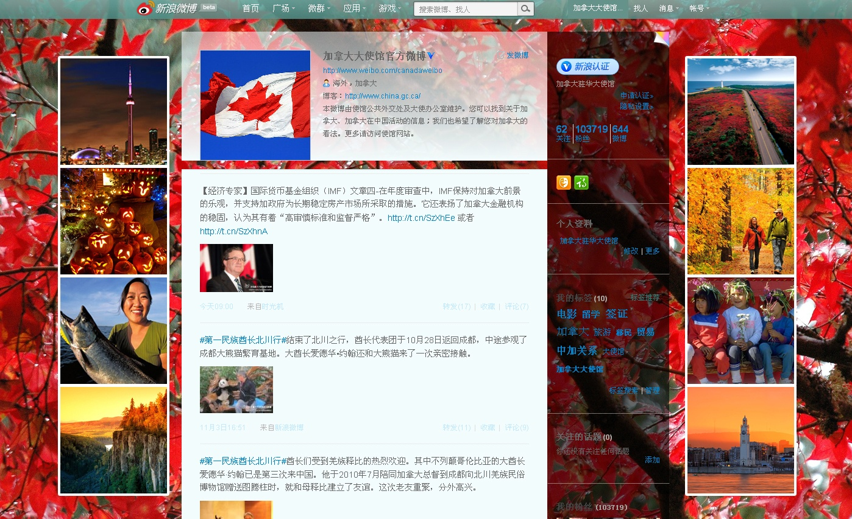
Social Media
Canadian embassy microblog in Chinese:
Currently more than 200K followers
Weibo.com/canadaweibo
Notes:
Benefit
Low cost
More geographic coverage
Messages are deemed as official.
13

Slide 14
Social Media
Notes:
Canadian Embassy is actively using social media to promote Canada. Its official Chinese microblog weibo has over 150000 followers now. 86000 last time we spoke in October 2011
Weibo.com/canadaweibo
CEE is featured live on weibo.
Facebook and Twitter are banned in China
14

Slide 15
Social Media
Major influential Chinese websites where students get information on studying abroad
Micro blog : weibo.com
BBS: www.taisha.org/bbs/
Social networking: www.renren.com
www.kaixin001.com
www.douban.com
Notes:
Benefit
Low cost
More geographic coverage
Messages are deemed as official.
15

Slide 16
Coming up…
Canada Pavilion at China Education Expo, Oct 20-Nov 3, 2012
Canadian MBA Business School Fair, Early September, 2012
China PhD Workshop, November 24-25, 2012
Canadian Education Fair, Qingdao, March 2013
Vocational education market reports commissioned by Beijing and Shanghai
Notes:
CEE: Beijing, Xi’an, Chengdu, Shanghai, Wuhan, Changsha, Guangzhou
16

Slide 17
www.international.gc.ca/education/events-evenements/index.aspx
www.tradecommissioner.gc.ca
Beijing.educationcanadachina@international.gc.ca
Notes:
Questions? Contact us.
Merci

